Slide 1

Joseph Silva Jr. 09/19/21
SNHU
IDS 403
3-2: Narrated Journal

Slide 2


Time and Society
Chosen Video: Time: How We Got to Now with Steven Johnson

Slide 3
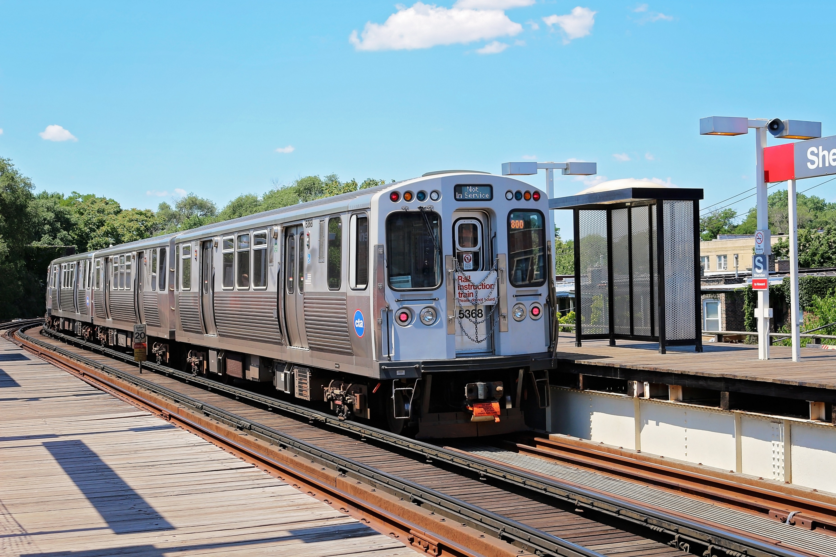
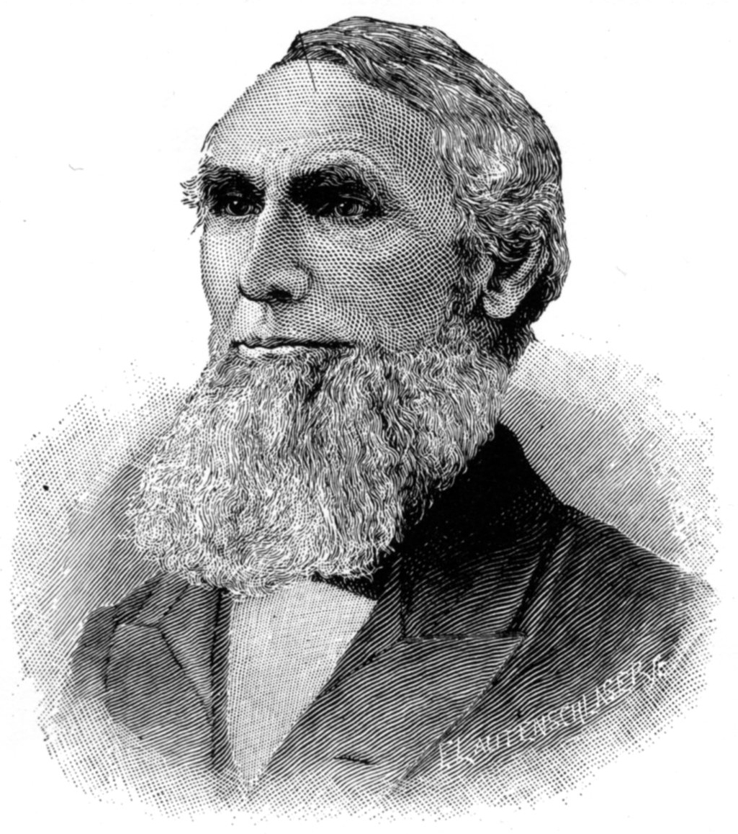

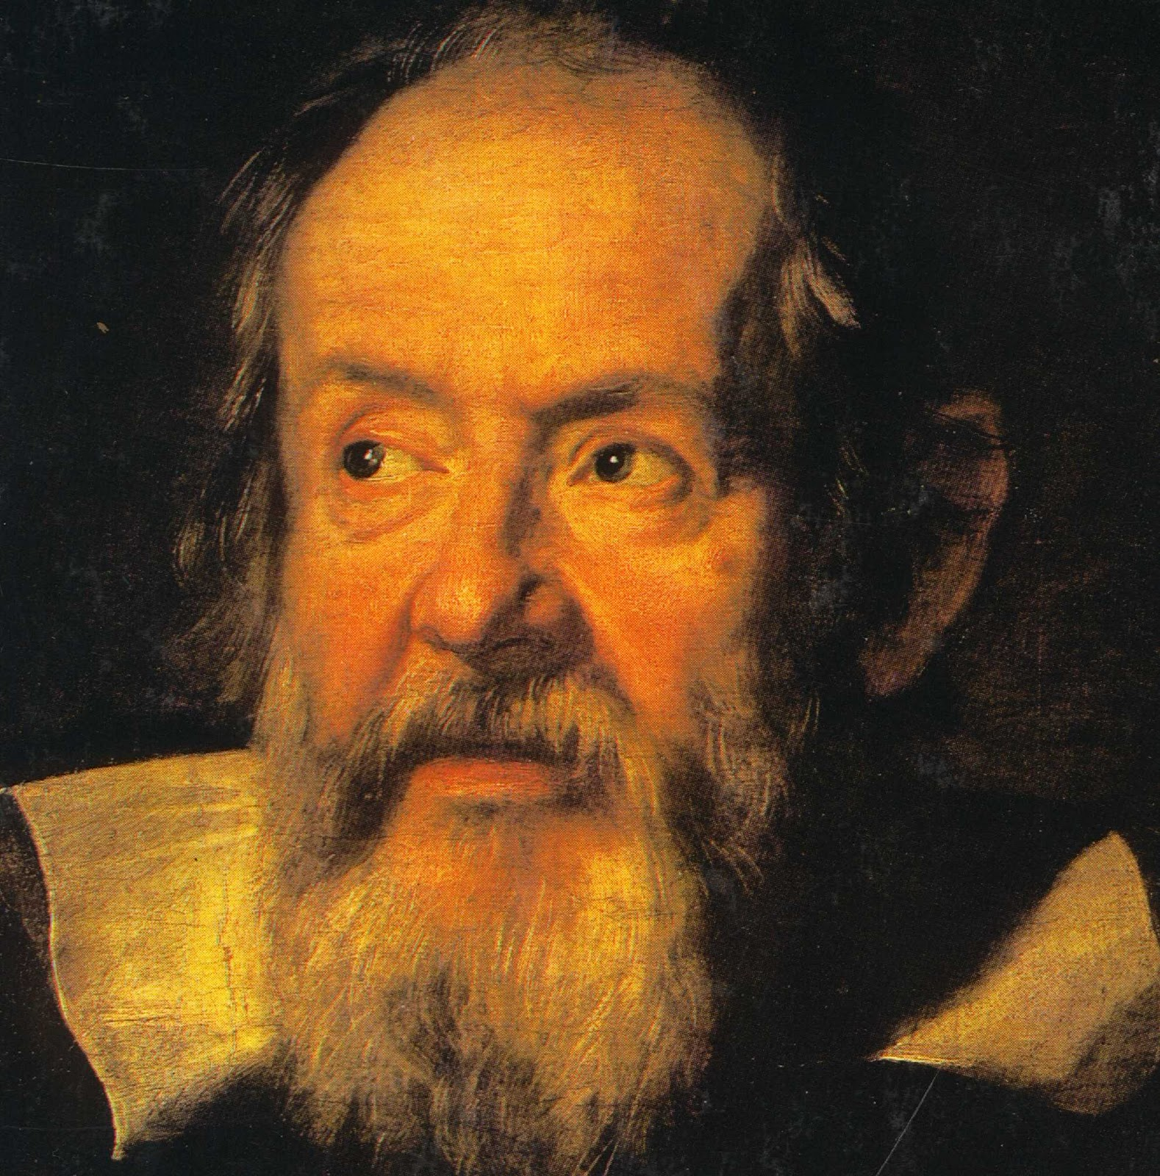
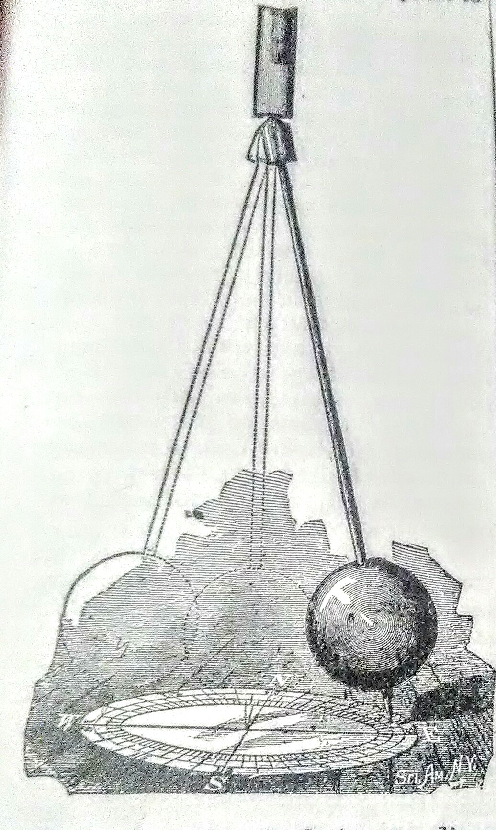
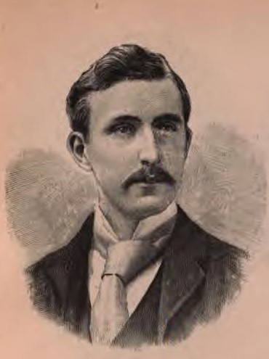
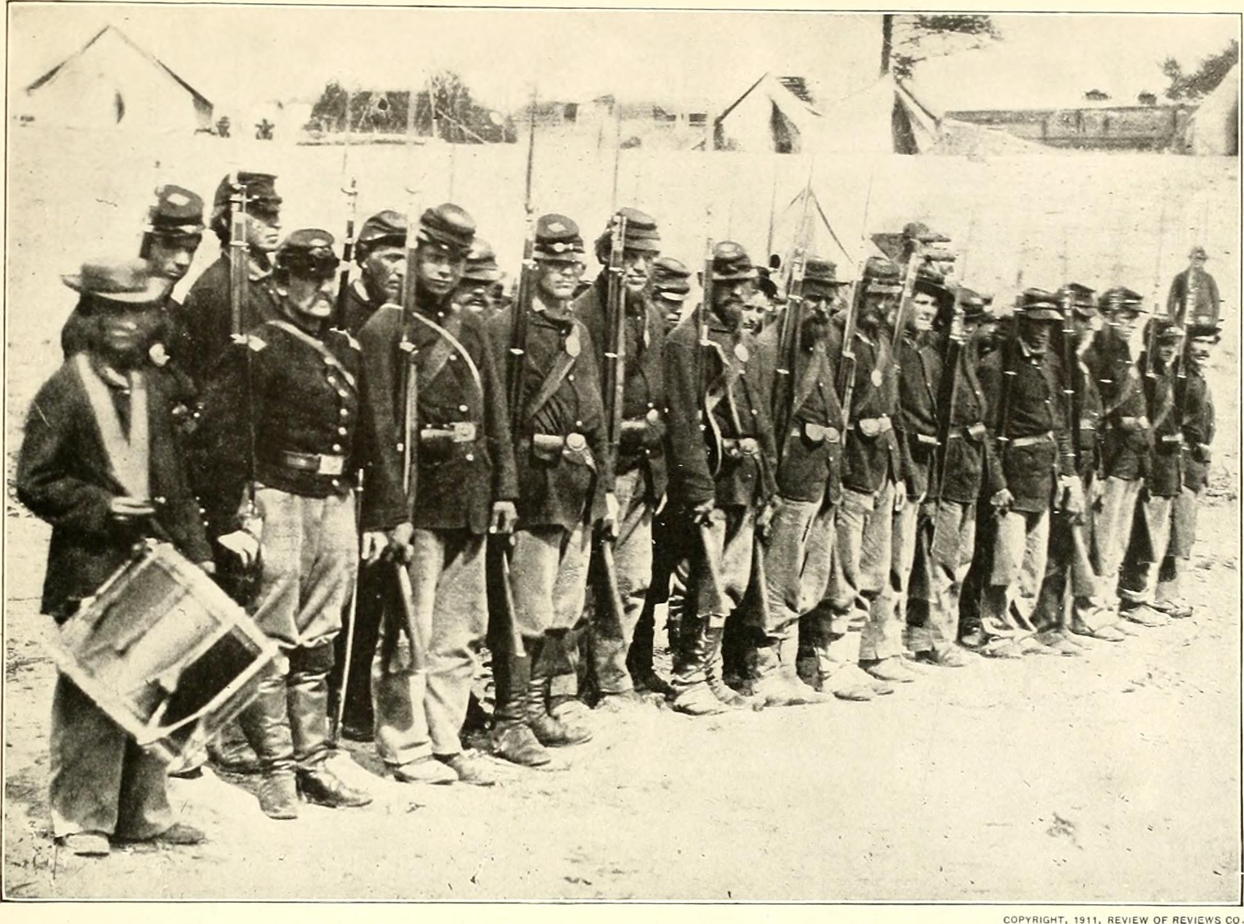
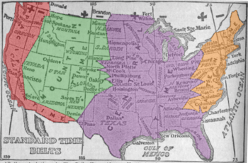
Video Characters’ Challenges
Galileo
Ideas vs Oneself
Aaron Dennison
Ideas vs Money and Fame
William Allen
Ideas vs Change

Slide 4
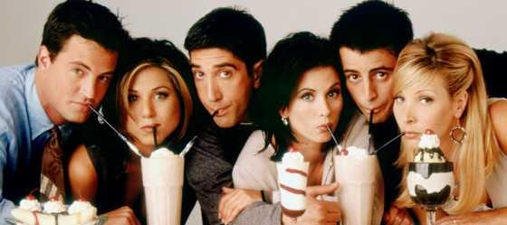


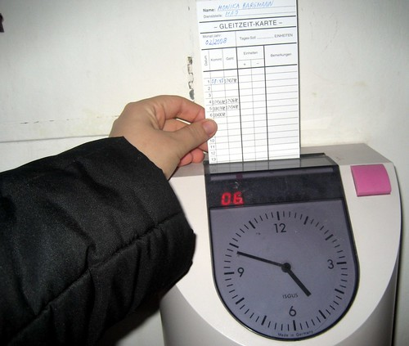


How does critically analyzing technology add value to interactions with people in personal and professional contexts?
Personal
Professional
This Photo by Unknown Author is licensed under CC BY-NC-ND

Slide 5
Citation (APA)
Films Media Group. (2014). Time: How we got to now with Steven Johnson. Films On Demand. Retrieved September 19, 2021, from https://fod.infobase.com/PortalPlaylists.aspx?wID=105049&xtid=60742.

